Slide 1
Fat Joe’s nightmare
A Side Scrolling Adventure

Slide 2
Introduction
We are the AU Capstone class!

Slide 3
Glossary
XNA
RPG
NPC
Tiles
Rendering
Layers
Ground
Mask
Fringe
Sprite sheets
Maps
XML
Serialization
C#
Sidescroller
Spritebatch
GUI
Player
Collision

Slide 4
Basic overview
Define what our game actually is.
The game is a sidescroller with RPG elements
For windows based systems pre windows 8
What the end goal is

Slide 5
Tools
Visual studio
C# and XNA
Github – source control
https://github.com/bullsfan127/AU_Capstone
Dropbox
Notes:
Jonathan

Slide 6
Tile Engine Overview
What is a Tile Engine?
How does it work?
Why did we choose to use it.
Notes:
Tim

Slide 7
What is a Tile Engine
2D rendering technique
64 x 64 pixel Tiles
Map size is restrained to 100,100
Multiple Layers

Slide 8
How it works
Pulls many small images from one large image
Lays specific “Tiles” on top of each other
Uses nested for loops
Shift view port based on player position

Slide 9
Why Did we Choose it
Easily Implemented
Quick
Detail oriented
Quickly prototyped
Flexible
Reusable

Slide 10
Physics Overview
Player Physics
Platform Physics
NPC Physics
Object Physics
Notes:
Mathias

Slide 11
Player Physics
Movement
Jumping
Falling
Collisions
Attacking
Being attacked

Slide 12
Platform Physics
Constrains movement
Defines Environment

Slide 13
NPC Physics
Ai handling
Collisions
movement

Slide 14
Object Physics
Make sure objects appear and can be interacted with

Slide 15
Art Overview
General Graphical Design
Concept Art
Tile specifics

Slide 16
Tiles
Background
Ground
Mask
Character
Fringe

Slide 17
Examples

Slide 18
Animation
What is it?
How it Works

Slide 19
Roleplaying Elements
What is a roleplaying element?
Stats
Player Health
Score
Items
NPC
Balancing and Testing

Slide 20
Interface
Buttons
Panels
Menus
Start Menu
Pause Menu
End Screen
Statistics
GUI

Slide 21
XML Serialization (Storage)
What is it?
How we use it!
Why do we use it?

Slide 22
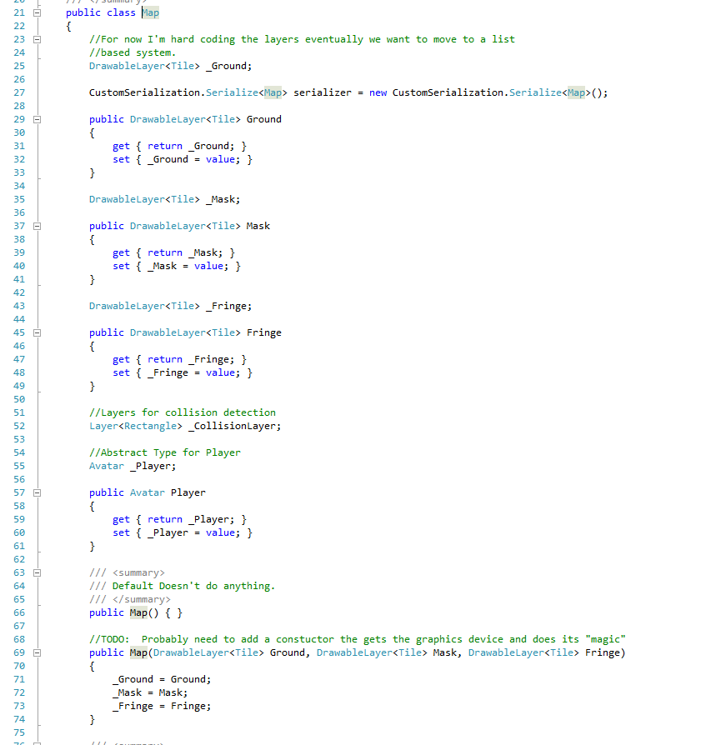
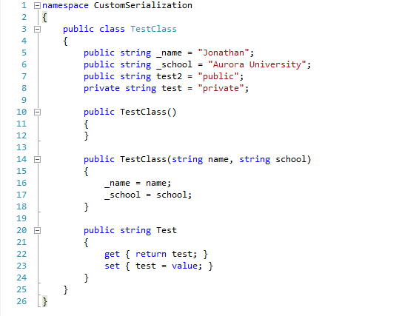

Slide 23
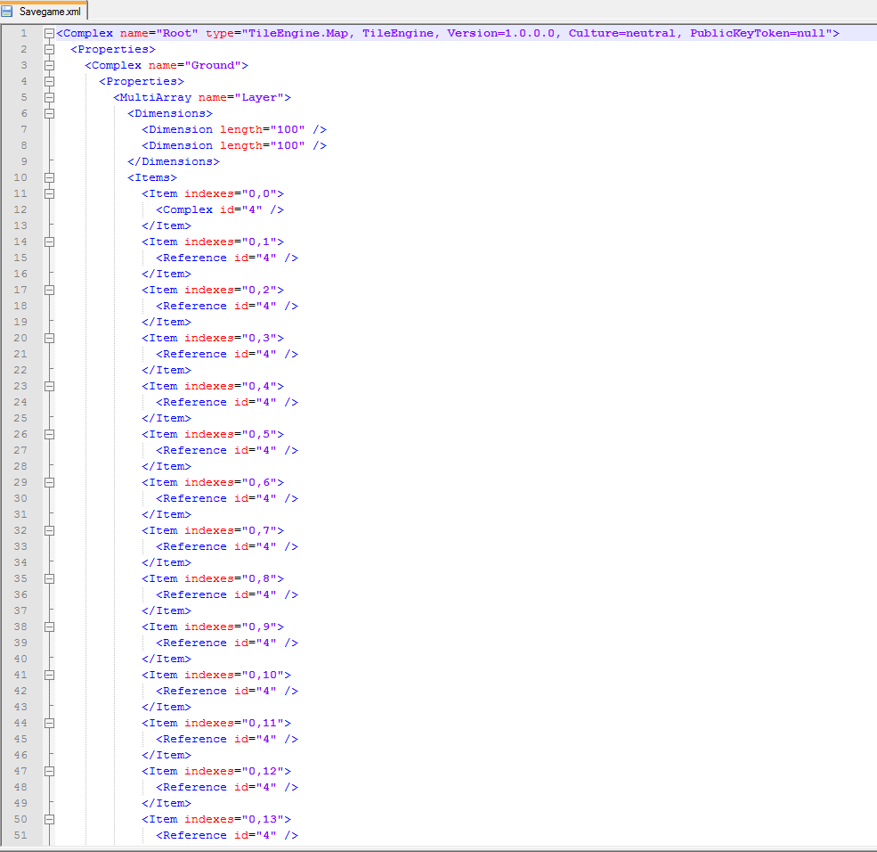
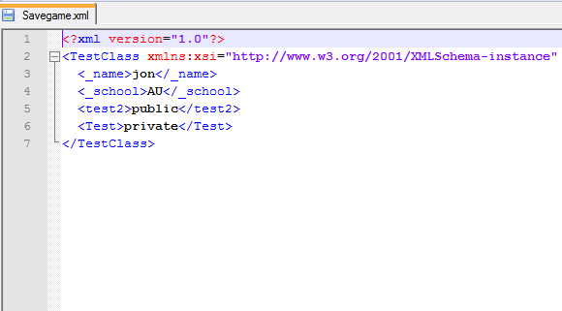

Slide 24
Why use it?
Volatile Vs. non-volatile memory
Save game state
Reduce memory consumption
More efficient game
Less objects to manage

Slide 25
Conclusion / Q&A
Demo
What is left to complete?
Code Integration
Testing
Documentation
Questions?

